Slide 1


Towards Word Logic Day, 2024
An Ontological Event
Abductive Reasoning and Argument Mining
Anatol Reibold
IMISE Leipzig + Cardisio GmbH

Slide 2
Content
Ontologies and Reasoning in Ontologies
Abductive Reasoning
Thesis, antithesis and synthesis: New aspects
Argumentation Theory
Argument Mining

Slide 3
Components of an ontology
Terms (in a natural language or terminology)
Concepts
Definitions
Relations (structure components)
Axioms (presumptions)
Calculus (reasoning, inference)
Criteria of plausibility

Slide 4
Reasoning in ontologies
The use of ontologies supports the structuring, creation and communication of knowledge
Hence is the reasoning in ontologies a dynamic process
Should the calculus within ontologies be a deductive calculus?
Question: Should the calculus within ontologies be a classical deductive calculus (predicate calculus, syllogisms a ct.) or/and a monotone logic?
These: In TLO, CDO and DO yes, but in Task Ontology (or in Use of Ontologies) not necessarily.

Slide 5
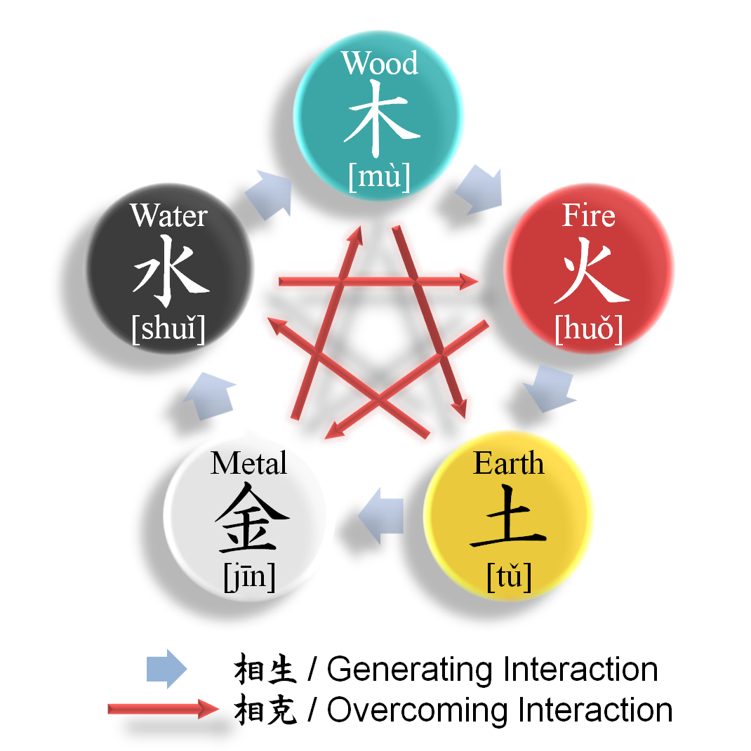
Wuxing
Does a thesis have to have only one antithesis?
Wuxing (Fire, Water, Wood, Metal, and Earth)
Generating Cycle Reverse
Generating Cycle
Destructive Cycle
Excessive Destructive Cycle
Value and change in value (derivation)
Wuxing
https://en.wikipedia.org/wiki/Wuxing_(Chinese_philosophy)

Slide 6
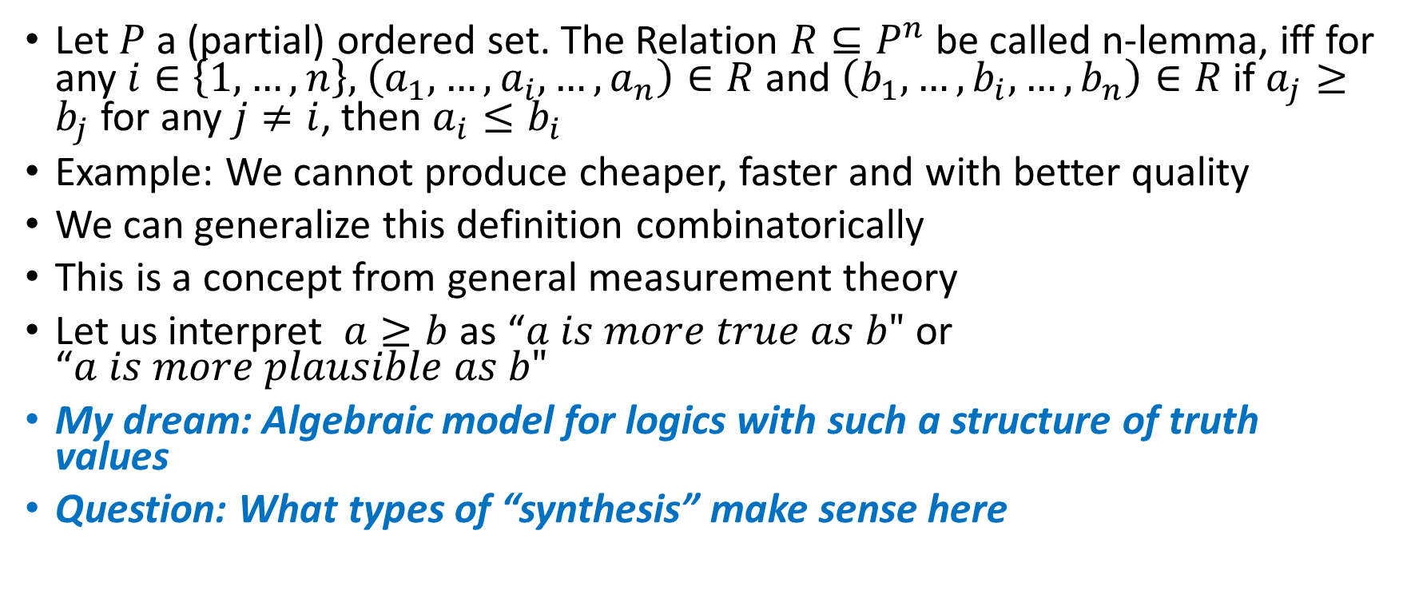
Dilemma, trilemma, n-lemma
Let $P$ a (partial) ordered set. The Relation $R⊆P^{n}$ be called n-lemma, iff for any $i∈\left\{1, …,n\right\},$ $\left(a_{1},…, a_{i},…,a_{n}\right)∈R$ and $\left(b_{1},…, b_{i},…,b_{n}\right)∈R$ if $a_{j}≥b_{j}$ for any $j≠i$, then $a_{i}≤b_{i}$
Example: We cannot produce cheaper, faster and with better quality
We can generalize this definition combinatorically
This is a concept from general measurement theory
Let us interpret $a≥b$ as “$a is more true as b"$ or “$a is more plausible as b"$
My dream: Algebraic model for logics with such a structure of truth values
Question: What types of “synthesis” make sense here

Slide 7
Eight reasons from Peirce
Eight reasons from Peirce for what we should seek in a candidate hypothesis to explain an observation or surprising fact:
The cost (in time, money, and effort) of testing the hypothesis
(1901, CP 6.533; 1901, CP 7.230);
The intrinsic value of the hypothesis regarding its ‘naturalness’ and ‘likelihood’ (1901, CP 7.223);
The fact that the hypothesis can be readily broken down into and elements and studies (1901, MS 692:33);
The simplicity of the hypothesis (i.e., it is more readily apprehended, more facile, more natural or instinctive) (1902, MS L75:286; 1901, CP 6.532; 1908, CP 6.477);
The breadth of the hypothesis or the scope of its predictions (1902, MS L75:241, 457:37);
The ease with which we may falsify the hypothesis (1902, MS L75:285);
The testability of the hypothesis using severe tests based on ‘incredible predictions’; and
The analogy of the hypothesis with familiar knowledge (1901, MS 873:16).

Slide 8
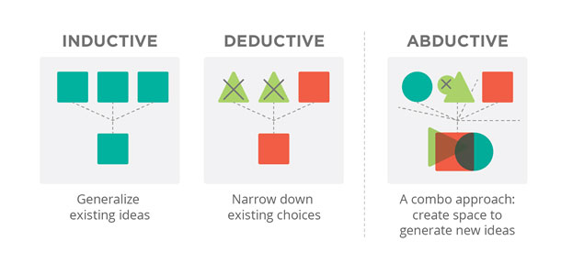
Abductive Reasoning for Business Success
When trying to solve a business problem, many corporate teams rely on one type of logic. The result: instead of collaborating, the members end up in a power struggle over whose idea will win. It’s frustrating for the team at large, and the solution chosen may be only temporary. Worse, teams may disband before the initial problem is solved. In contrast, by borrowing from traditional academic approaches to problem solving, UX designers use three types of logic to create better solutions (see Figure 1, Credit: Pivot Design Group):
Inductive logic (generalize solutions that already exist)
Deductive logic (narrow down existing choices)
Abductive reasoning (a combination of inductive and deductive methods that encourages expansive thinking)

Slide 9
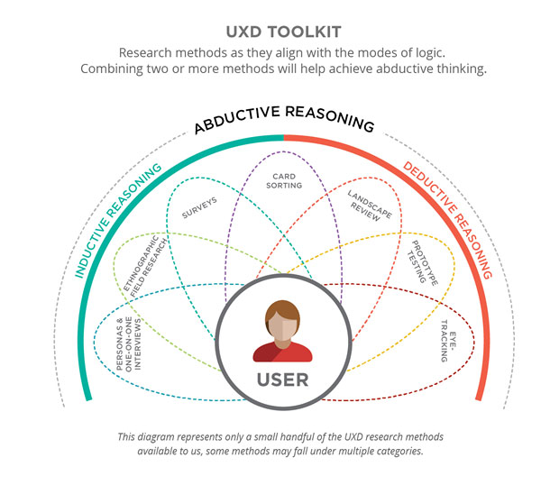

Slide 10
Argumentation Theory
Argumentation Schemes und Informal Logic (D. N. Walton)
The Periodic Table of Arguments (PTA) (Jean H.M. Wagemans)
Cognitive architecture BOID (Belief, Obligation, Intention and Desire) and Abductive Reasoning

Slide 11
Twelve characteristics of logical argumentation I
“1. The procedure for examining and criticizing the arguments on both sides forms a dialogue structure in which two sides take turns putting forward speech acts (e.g., making assertions or asking questions).
2. The dialogue has rules for incurring and retracting commitments that are activated by speech acts. For example, when a participant makes an assertion, he or she becomes committed to the proposition contained in the assertion.
3. The method uses the notion of commitment or acceptance as the fundamental tool for the analysis and evaluation of argumentation rather than the notion of belief. The reason is that belief is a psychological notion internal to an agent.
4. The method assumes a database of commonly accepted knowledge that, along with other commitments, provides premises for arguments. The knowledge base is set in place at the opening stage, but can be revised as new relevant information needs to be collected and considered.

Slide 12
Twelve characteristics of logical argumentation II
5. The procedure is dynamic, meaning that it continually updates its database as new information comes in that is relevant to an argument being considered.
6. The arguments advanced are (for the most part) defeasible, meaning that they are subject to defeat as new relevant evidence comes in that refutes the argument.
7. Conclusions are accepted on a presumptive basis, meaning that in the absence of evidence sufficient to defeat it, a claim that is the conclusion of an argument can be tentatively accepted, even though it may be subject to later defeat as new knowledge comes in.
8. The method analyzes and evaluates argumentation concerning a claim where there is evidence for it as well as against it. Thus any argument is subject to critical questioning until closure of the dialogue.

Slide 13
Twelve characteristics of logical argumentation III
9. The dialogue uses critical questioning as a way of testing plausible explanations and finding weak points in an argument that raise doubt concerning the acceptability of the argument.
10. The method uses standards of proof. Criteria for acceptance are held to depend on standards that require the removal of specifiable degrees of reasonable doubt.
11. The methods applied include defeasible argumentation schemes, deductive arguments, inductive arguments, presumptive arguments and argument visualization software tools.
12. The method comprises the study of explanations as well as arguments, including the form of argument called inference to the best explanation, or abductive reasoning.”
Remark: This characteristics are criteria for correct informal reasoning from the point of view of common sense

Slide 14
Scheme for argument from expert opinion
“Major Premise: Source E is an expert in subject domain S containing proposition A .
Minor Premise: E asserts that proposition A is true (false).
Conclusion: A is true (false).
The following critical questions represent standard ways of casting the argument into doubt.
CQ 1 : Expertise Question . How credible is E as an expert source?
CQ 2 : Field Question . Is E an expert in the field that A is in?
CQ 3 : Opinion Question . What did E assert that implies A ?
CQ 4 : Trustworthiness Question. Is E personally reliable as a source?
CQ 5 : Consistency Question. Is A consistent with what other experts assert?
CQ 6 : Backup Evidence Question. Is E ’s assertion based on evidence?”

Slide 15
Some common argumentation schemes

Slide 16
Some common types of speech acts

Slide 17
Seven types of dialogue

Slide 19
Periodic Table of Arguments (PTA):
Argument form I
Alpha. In argumentation with the form a is X because a is Y, conclusion and premise have the same subject and a different predicate
This book (a) is great (X) because it (a) was written by Javier Marías (Y)
Beta. In argumentation with the form a is X because b is X, it is exactly the other way around: the conclusion and the premise have the same predicate but a different subject.
Mars (a) is inhabited (X) because Earth (b) is also inhabited (X)

Slide 20
Periodic Table of Arguments (PTA):
Argument form II
Gamma. In this case, the argument takes the form a is X, because b is Y. Such argumentation is based on a similarity in the relationship of the subjects and predicates to each other
Self-control (a) is good (X) because hot temper (b) is bad (Y)
If we indicate that property by ‘Z’, the conclusion by ‘q’, and the acceptability of the conclusion by ‘A’, we can reconstruct the argument form as q [is A], because q is Z.
The economy has grown (q) [is acceptable (A)], because that (q) was said by the Prime Minister (Z)

Slide 21
Argument Mining
“Argument Mining is the automatic identification of argumentative structures in text.”
A large number of publications on the topic of argument mining have been published since 2019. In particular, there are several articles with code (mostly in Python).
https://paperswithcode.com/task/argument-mining
https://github.com/topics/argument-mining
https://www.uni-trier.de/fileadmin/fb4/prof/INF/DBI/Publikationen/comma20_lenz_sahitaj.pdf (Towards an Argument Mining Pipeline Transforming Texts to Argument Graphs )
https://library.gito.de/wp-content/uploads/2021/08/C9Wambsganss-Unlocking-Transfer-Learning-in-Argumentation-Mining-274_c.pdf (Unlocking Transfer Learning in Argumentation Mining: A Domain-Independent Modelling Approach )

Slide 22
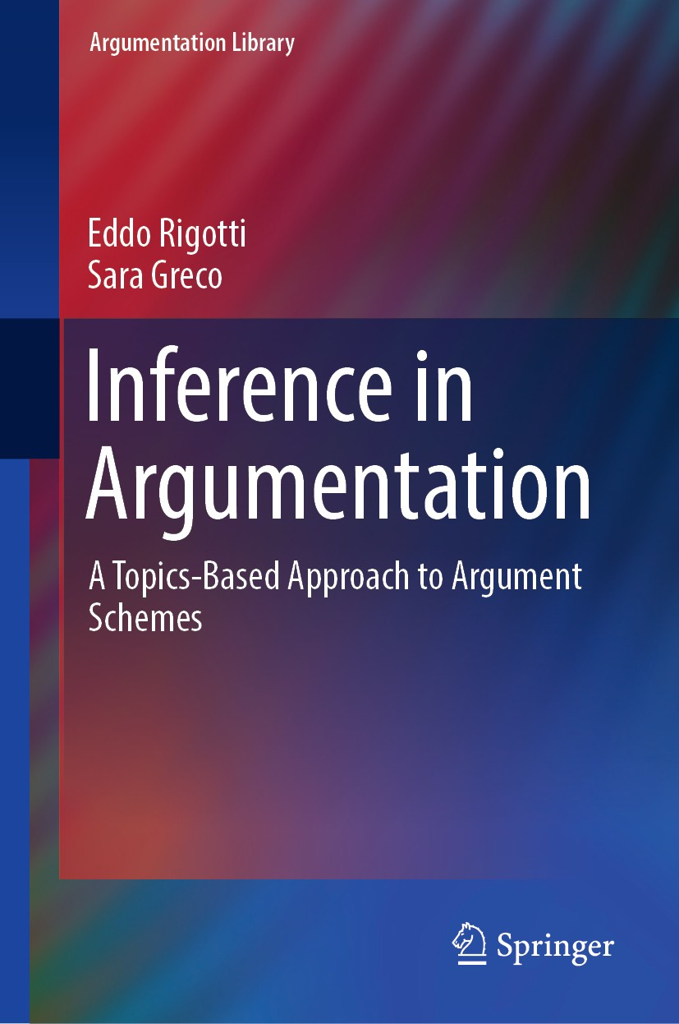
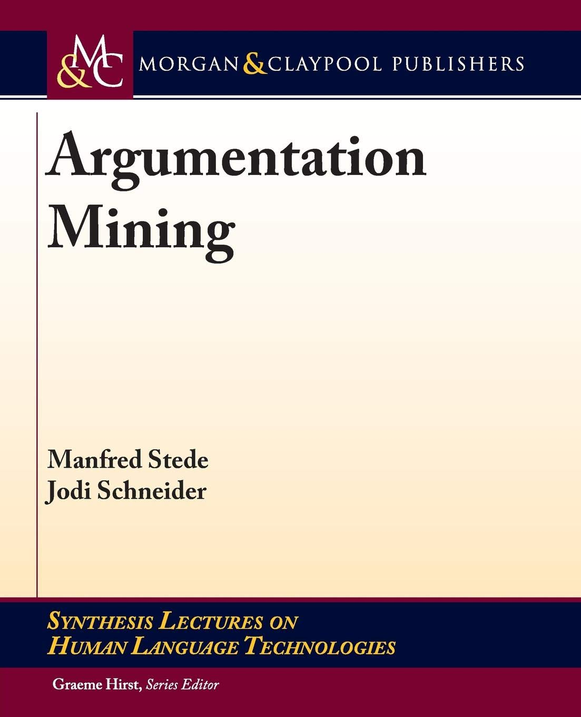
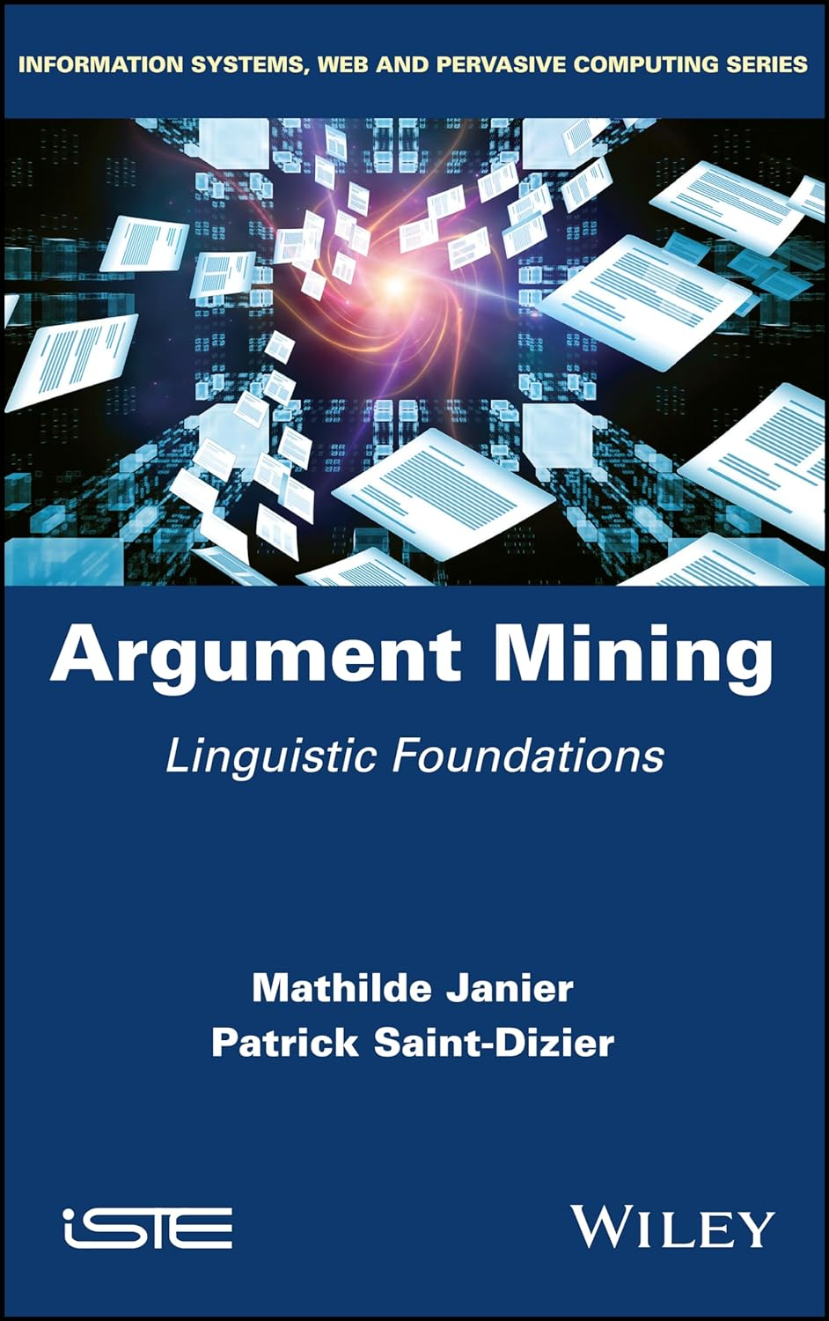
Argument Mining (Books)

Slide 23
Argument Mining in different contexts
The book "Inference in Argumentation: A Topics-Based Approach to Argument Schemes" focuses on how argumentation patterns or rules can be applied in different contexts. These patterns are applied to specific topics or contexts in order to formulate clear and convincing arguments. It places an emphasis on how people can draw conclusions through rational argumentation and how this skill can be used in different discussion situations. Overall, the book provides a comprehensive insight into the structures of argumentation and how these structures can be used to develop persuasive arguments in different contexts. Very good historical overview of the topic. Toulmin Model vs. Model of Perelman and Olbrechts-Tyteca.

Slide 24
Argument-as-Activity
“Argumentation is a verbal, social, and rational activity aimed at convincing a reasonable critic of the acceptability of a standpoint by putting forward a constellation of propositions justifying or refuting the proposition expressed in the standpoint.” (van Eemeren and Grootendorst)
A verbal activity
A social activity
A rational activity
A standpoint
Convincing of acceptability
A constellation of propositions
Justifying the proposition of the standpoint
A reasonable critic
ADU (argumentative discourse units ) and Speach Acts

Slide 25
Argument Mining (Internet Links)
A large number of publications on the topic of argument mining have been published since 2019. In particular, there are several articles with code (mostly in Python).
https://paperswithcode.com/task/argument-mining
https://github.com/topics/argument-mining
https://www.uni-trier.de/fileadmin/fb4/prof/INF/DBI/Publikationen/comma20_lenz_sahitaj.pdf (Towards an Argument Mining Pipeline Transforming Texts to Argument Graphs )
https://library.gito.de/wp-content/uploads/2021/08/C9Wambsganss-Unlocking-Transfer-Learning-in-Argumentation-Mining-274_c.pdf (Unlocking Transfer Learning in Argumentation Mining: A Domain-Independent Modelling Approach )

Slide 26
Argument Mining and Translation (Question)
Text in Language 1 (for Example English) -> Translation in Language 2 (for Example Romanian) -> Identification of Argument 3 in Text 2 (as part of text) -> Identification of the part 4 of text 1 that corresponds to part 3 when translated
Is part 4 also an argument?
Can argument 4 be identified as argument in text 1?
Is it possible to identify additional arguments in texts in this way?
I don't know the answer to this question. This is just an idea.

Slide 27
Bibliography (Abductive Theory I)
https://en.wikipedia.org/wiki/Charles_Sanders_Peirce_bibliography
George Pólya “Mathematics and Plausible Reasoning“, 1954
Hans Vaihinger “The Philosophy of 'As If”, 1968
Tomis Kapitan “In What Way Is Abductive Inference Creative?,” Transactions of the Charles S. Peirce Society, vol. 26, 1990, pp. 499–512
Tomis Kapitan “Peirce and the Autonomy of Abductive Reasoning,” Erkenntnis, vol. 37, 1992, pp. 1–26.
Lorenzo Magnani “Abduction, Reason, and Science Processes of Discovery and Explanation”, 2001
John R. Josephson and Susan G. Josephson (Editors) “Abductive Inference. Computation, Philosophy, Technology“, 2003
Atocha Aliseda “Abductive Reasoning Logical Investigations into Discovery and Explanation”, 2006

Slide 28
Bibliography (Abductive Theory II)
Lorenzo Magnani “Abductive Cognition. The Epistemological and Eco-Cognitive Dimensions of Hypothetical Reasoning”, 2009
Douglas N. Walton “Abductive Reasoning”, 2014
Iffat Jokhio and Ian Chalmers “Using Your Logical Powers: Abductive Reasoning for Business Success”, 2015 User Experience Magazine, 15(4).
Gianluca Caterina and Rocco Gangle “Iconicity and Abduction“, 2016
Woosuk Park “Abduction in Context The Conjectural Dynamics of Scientific Reasoning”, 2017
Lorenzo Magnani “The Abductive Structure of Scientific Creativity. An Essay on the Ecology of Cognition”, 2017
Lorenzo Magnani (Editor) “Handbook of Abductive Cognition”, 2023

Slide 29
Bibliography (Douglas N. Walton)
“Dialog Theory for Critical Argumentation”, 2007
“Media Argumentation. Dialectic, Persuasion, and Rhetoric”, 2007
Douglas N. Walton, Chris Reed, Fabrizio Macagno “Argumentation Schemes”, 2008
“Media Argumentation. Dialectic, Persuasion, and Rhetoric”, 2008
“Argumentation Schemes for Presumptive Reasoning”, 2009
„Methods of Argumentation”, 2013

Slide 30
Bibliography (Argumentation Theory)
Frans H. van Eemeren “Argumentation Theory: A Pragma-Dialectical Perspective“, 2018
Raymond S. Nickerson “Argumentation The Art of Persuasion”, 2021
https://informallogic.ca/index.php/informal_logic “Informal Logic. Reasoning and Argumentation in Theory and Practice” (Journal)
Jean H.M. Wagemans “How to identify an argument type? On the hermeneutics of persuasive discourse”, Journal of Pragmatics 203 (2023) 117-129
https://periodic-table-of-arguments.org/ “Periodic Table of Arguments. The Atomic Building Blocks of Persuasive Discourse”

Slide 31
Bibliography (Argument Mining)
Frans H. van Eemeren and Rob Grootendorst “A Systematic Theory of Argumentation: The pragma-dialectical approach”, 2004
Eddo Rigotti and Sara Greco "Inference in Argumentation. A Topics-Based Approach to Argument Schemes", 2019
Manfred Stede and Jodi Schneider "Argumentation Mining", 2019
Mathilde Janier and Patrick Saint-Dizier "Argument Mining. Linguistic Foundations", 2019
Mirko Lenz, Premtim Sahitaj, Sean Kallenberg, Christopher Coors, Lorik Dumani, Ralf Schenkel, and Ralph Bergmann “Towards an Argument Mining Pipeline Transforming Texts to Argument Graphs”, 2020, in “Frontiers in Artificial Intelligence and Applications“
Thiemo Wambsganss, Nikolaos Molyndris, Matthias Söllner “Unlocking Transfer Learning in Argumentation Mining: A Domain-Independent Modelling Approach”, 2021, in “15 th International Conference on Wirtschaftsinformatik, 2020“

